Slide 1
Push Down Automata
Lecture -8

Slide 2
Topics
Push Down Automata
Examples
PDA and CFG

Slide 3
How will you Implement Context Free Grammar for Compilers?

Slide 4
Push Down Automata
PDA can write symbols on the stack(LIFO) and read them back later .
Writing a symbol pushes down all the symbols on the stack.
At any time ,the symbol on the top of the stack can be read.
Writing is referred as pushing and reading is referred as popping.
Stack is referred as “Last In First Out” Storage device.

Slide 5
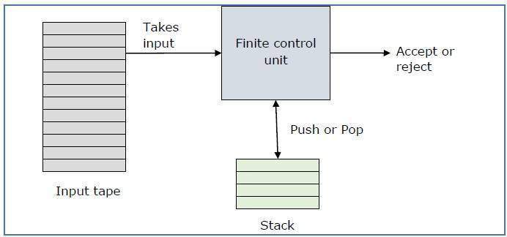
PDA

Slide 6
Push Down Automata
A pushdown automaton is a way to implement a context-free grammar
in a similar way we design DFA for a regular grammar.
A DFA can remember a finite amount of information, but a PDA can
remember an infinite amount of information.
Def 8: A push-down automata is a tuple M = (Q, ∑, δ, Γ, s, F) where:
(same) Q is a finite set of states
(same) ∑ is an alphabet
(new) Γ is the stack alphabet
(same) q₀ ∈ Q is the initial state
(same) F ⊆ Q is the set of final states
(new) δ, the transition relation is a finite subset of

Slide 7
PDA
"Finite state machine" and "a stack“
(Q x (∑ υ {ε}) x Γ*) (Q x Γ*)

Slide 8
PDA
A pushdown automaton has three components −
an input tape,
a control unit, and
a stack with infinite size.
The stack head scans the top symbol of the stack.
A stack does two operations −
Push − a new symbol is added at the top.
Pop − the top symbol is read and removed.
A PDA may or may not read an input symbol, but it has to read the top of the stack in every transition.

Slide 9
Move Operations in Stack
String in the tape can be pushed to the stack
Top element in the stack can be popped
Top element is replaced by string of stack symbols.

Slide 10
Steps for PDA
No of Push operations should be equal to number of pop operations.
All the elements present in the Input tape should be read.
After completing all the operations the stack should be left as empty(∈) or with some element (z₀ )

Slide 11
Example –a^{n}b^{n}
Push a
Pop a
a
a
z
a
a
z
Push a
Pop a
Push a
Pop a
Top of the stack

Slide 12
Pushdown Automata Acceptance
There are two different ways to define PDA acceptability.
Final State Acceptability:
From the starting state, we can make moves that end up in a final state with any stack values.
Empty Stack Acceptability
Stack is empty after reading all the strings.

Slide 13
Check whether string “aabaa” accepted by push down automata
Stack
a | a | b | a | a
z₀
a
z₀
Push ‘a’ when z₀ is on the top of stack
a | a | b | a | a
a
z₀
a
a
z₀
Push ‘a’ when a is on the top of stack

Slide 14
Check whether string “aabaa” accepted by push down automata
Stack
a
a
z₀
a
a
Z₀
Stop Push Operation
a | a | b | a | a
a
z₀
Pop ‘a’ when a is on the top of stack
a
a
z₀
a | a | b | a | a
Pop ‘a’ when a is on the top of stack
a
z₀
z₀
a | a | b | a | a

Slide 15
State Transition table-Final State Acceptability
L = {aabaa}
Input Tape | _{Stack} | _{Operation}
δ (q_{0,} a, z₀ ) | q₁ , az₀ | Push
δ (q_{1,}a, a) | q₁ , aa | Push
δ (q₁, b, a) | q₁ , aa | Stop push
δ (q₁, a, a) | q₂ , az₀ | Pop a
δ (q₂, a, a ) | q_{f,} z₀ | Pop a

Slide 16
Example-1(PDA) Final State Acceptability
PDA for accepting L = { aabaa}
b,a/aa (stop push)
a,a/aa (Push)
(Push)
a,z₀/az₀ a,a/az₀(pop) a,a/z₀(pop)
q_{f}
q0
q1
q2

Slide 17
State Transition table-Empty State Acceptability
L = {aabaa}
Input Tape | _{Stack} | _{Operation}
δ (q_{0,} a, ∈ ) | q₁ , a | Push
δ (q_{1,}a, a) | q₁ , aa | Push
δ (q₁, b, a) | q₁ , aa | Stop push
δ (q₁, a, a) | q₂ , a | Pop a
δ (q₂, a, a ) | q_{2,} ∈ | Pop a

Slide 18
Example-1(PDA) EmptyState Acceptability
PDA for accepting L = { aabaa}
b,a/aa (stop push)
a,a/aa (Push)
(Push)
a, ∈/a a,a/a, ∈(pop)
a,a/ ∈ (pop)
q0
q1
q2

Slide 19
Try Example-3(PDA)
PDA for accepting L = {a^{n}b^{n}c^{m} | n =2 ,m=1}
PDA for accepting L={aabbaaba}
PDA for accepting L={aaaabbbb}
PDA for accepting L={010101011}

Slide 20
PDA & Context-Free Grammar
Conclusion
Push automata can be designed with acceptance by final state
Push automata can be designed with acceptance by empty stack.

